Slide 1


Slide 2
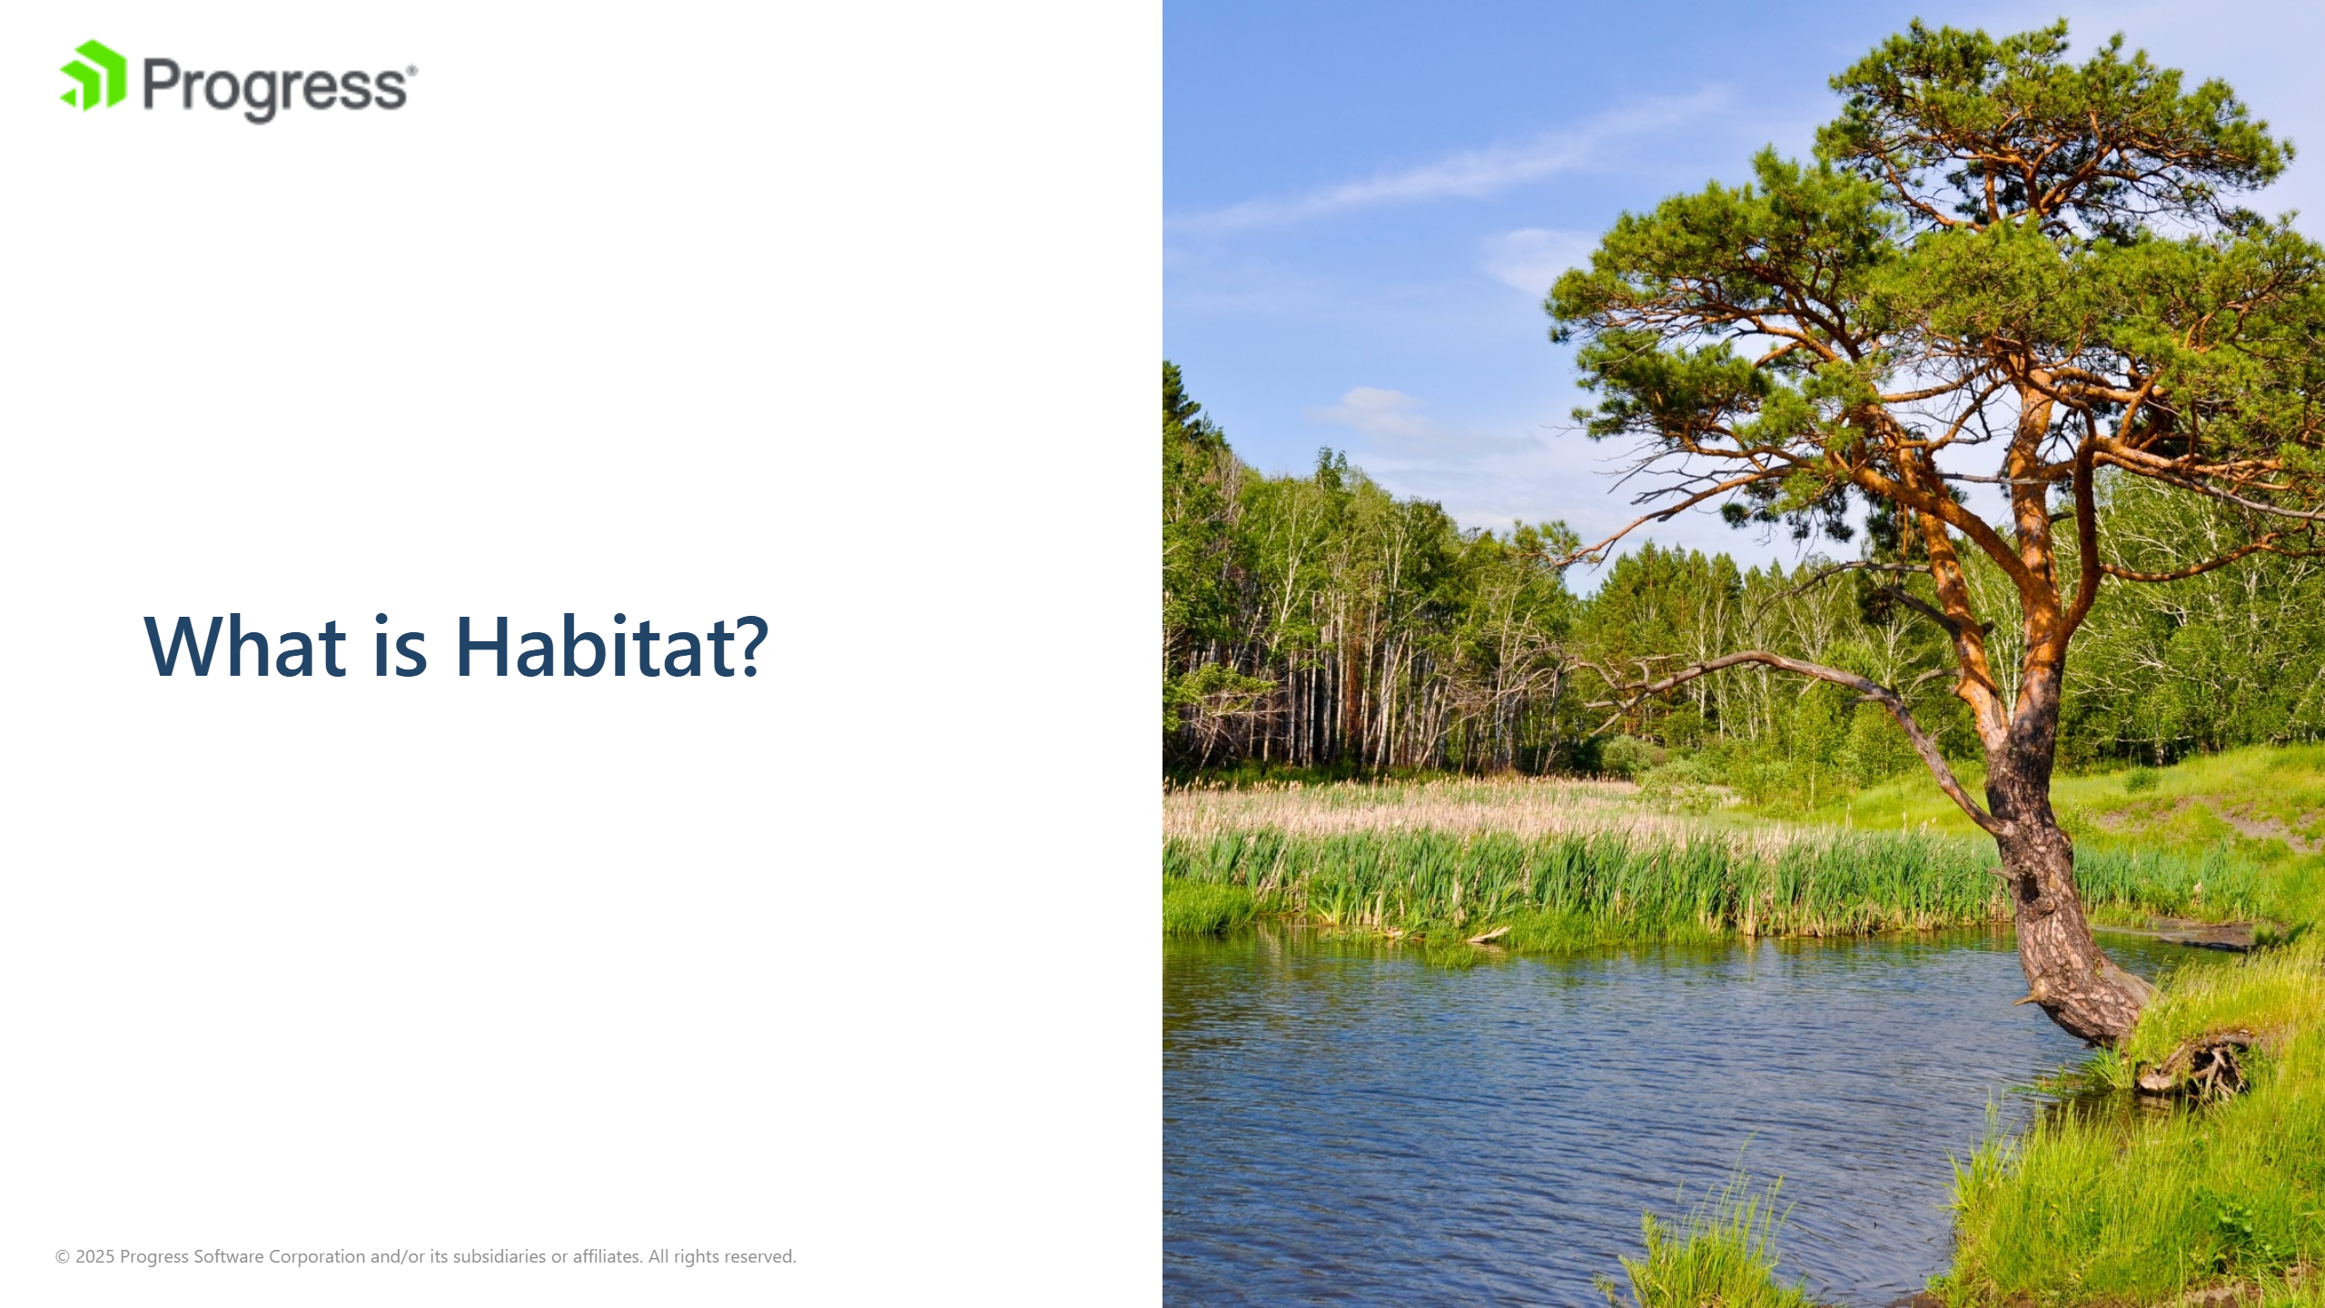
Notes:
image source: "https://get.pxhere.com/photo/landscape-tree-nature-forest-wilderness-plant-shore-flower-lake-river-summer-pond-pine-savanna-vegetation-wetland-reeds-habitat-ecosystem-natural-environment-woody-plant-1112797.jpg"

Slide 3


Slide 4


Slide 5
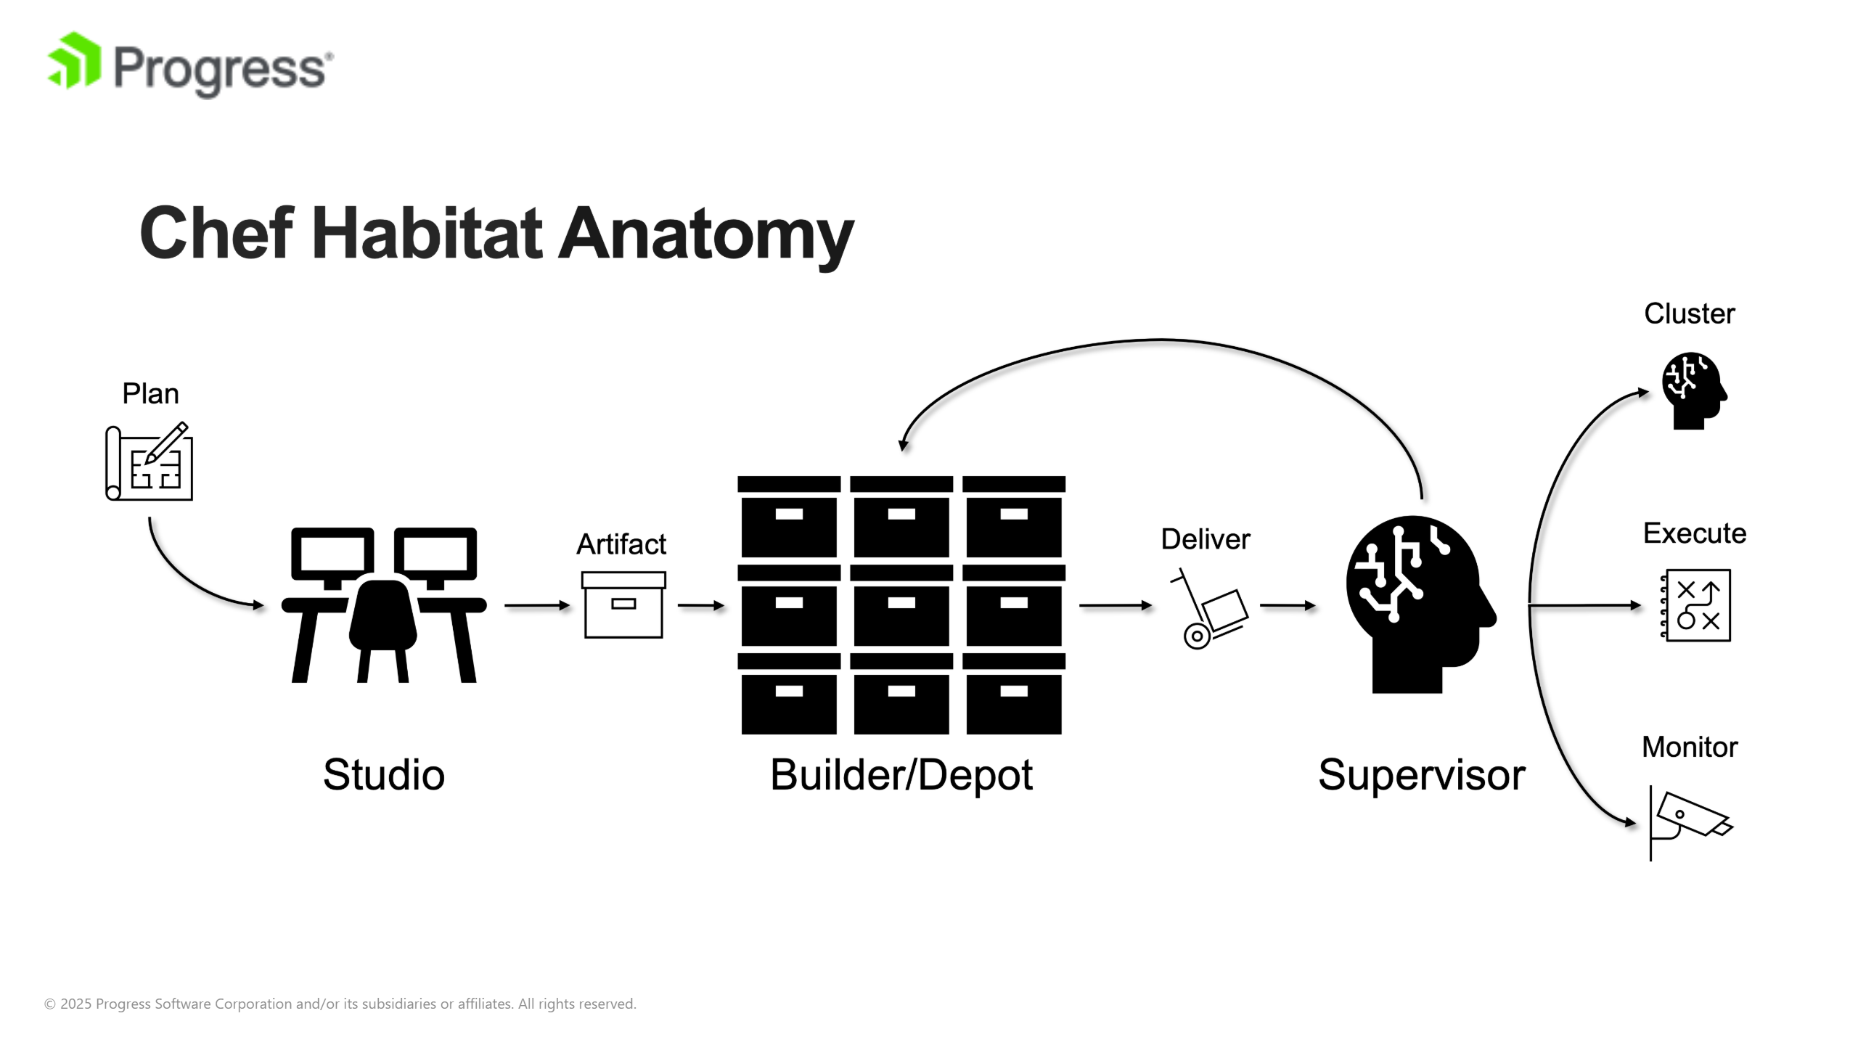

Slide 6


Slide 7


Slide 8
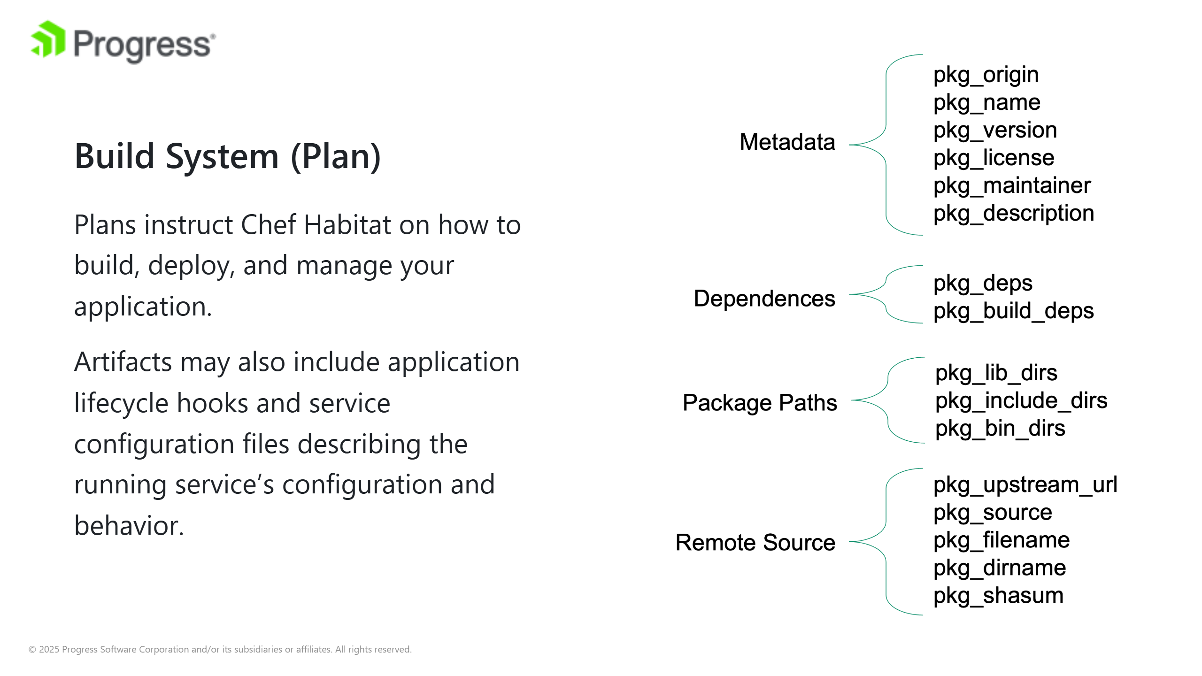

Slide 9
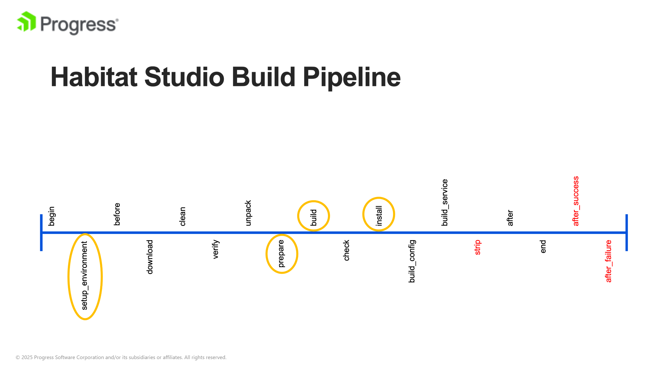

Slide 10
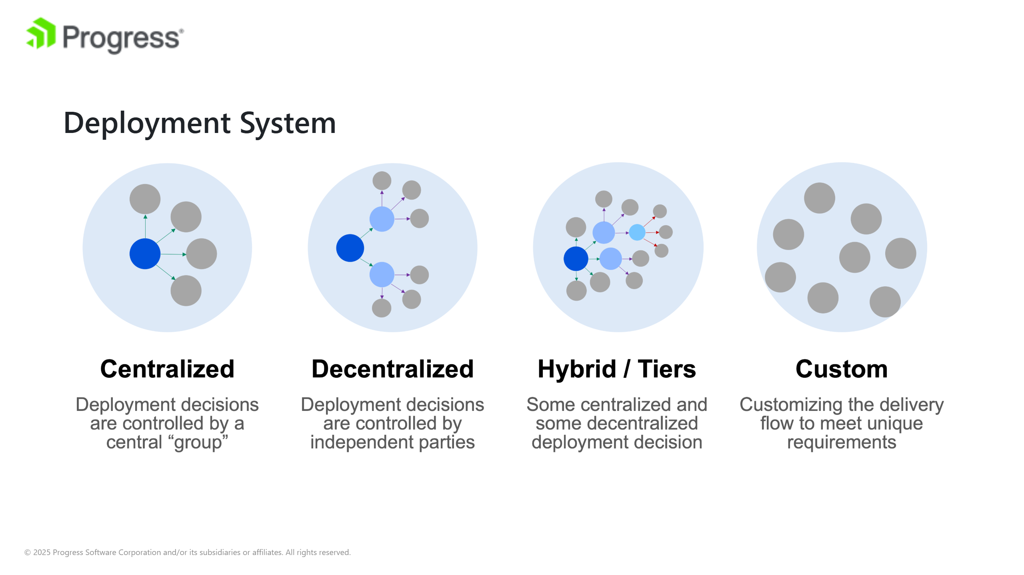

Slide 11


Slide 12
